Slide 1
BRITISH AIRWAYS
PREDICTING CUSTOMER BUYING BEHAVIOUR

Slide 2
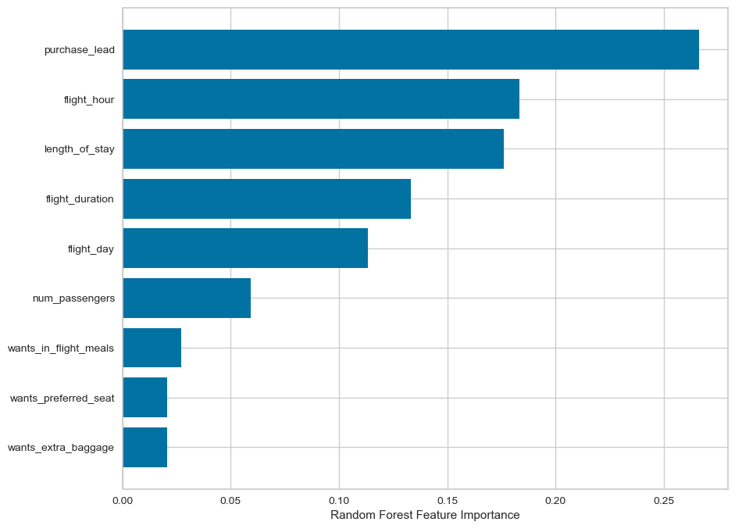
Key Metrics
Bookings by Mobile
11.24%
Bookings by Internet
88.76%
Total Number of Bookings
50,000
It was observed that purchase_lead was the most prevailing feature that contributes to a customer completing a booking application and this was followed by flight hour. Preferred seats and extra baggage did not really matter much to customer’s decision to complete a booking application. This result comes with a mean accuracy of 61.2%.
NB: We balanced the dataset before obtaining this result.

